Slide 1



Atliq grand Data analysis
View in Power BI
Last data refresh:
17/03/2025 04:52:15 UTC
Downloaded at:
17/03/2025 04:59:01 UTC

Slide 2
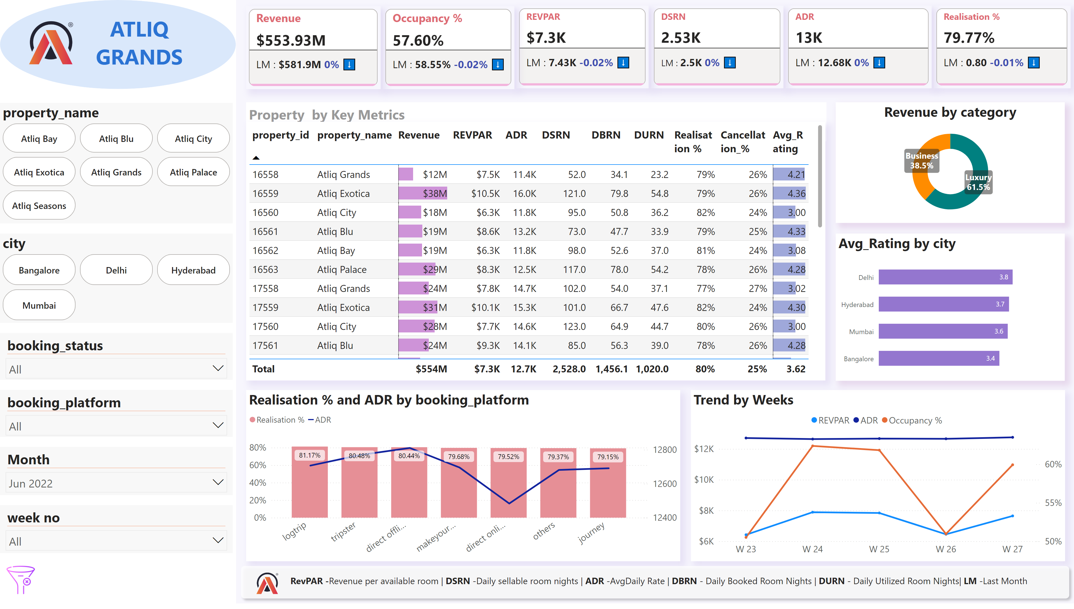
Report
Notes:
shape
No alt text provided
image
No alt text provided
shape
No alt text provided
textbox
No alt text provided
advancedSlicerVisual
No alt text provided
slicer
No alt text provided
slicer
No alt text provided
slicer
No alt text provided
slicer
No alt text provided
advancedSlicerVisual
No alt text provided
cardVisual
No alt text provided
Trend by Weeks
No alt text provided
barChart
No alt text provided
lineStackedColumnComboChart
No alt text provided
tableEx
No alt text provided
image
No alt text provided
textbox
No alt text provided
donutChart
No alt text provided
shape
No alt text provided
image
No alt text provided
textbox
No alt text provided
cardVisual
No alt text provided
cardVisual
No alt text provided
cardVisual
No alt text provided
cardVisual
No alt text provided
cardVisual
No alt text provided

